Slide 1

CHATBOT
Joel mendonza
Jorge Sabogal
Moulya pradeep

Slide 2
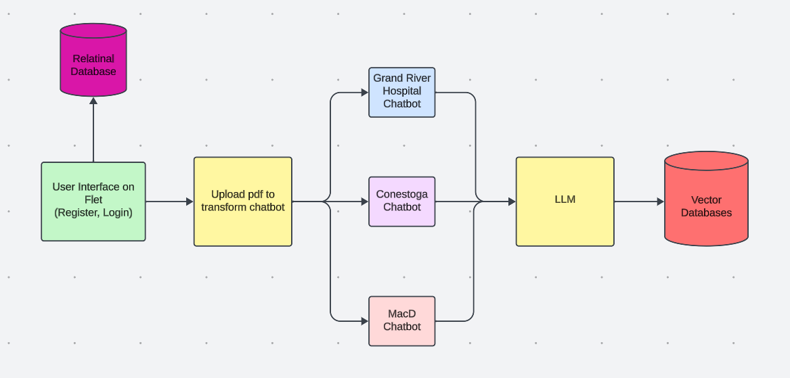
High Level Design

Slide 3
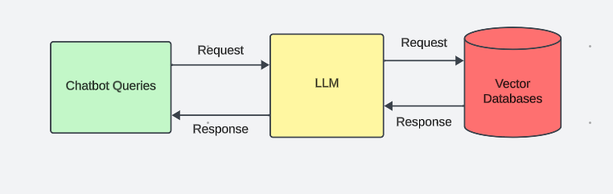
High Level Design Continued

Slide 4


Slide 5


Slide 6


